Slide 1
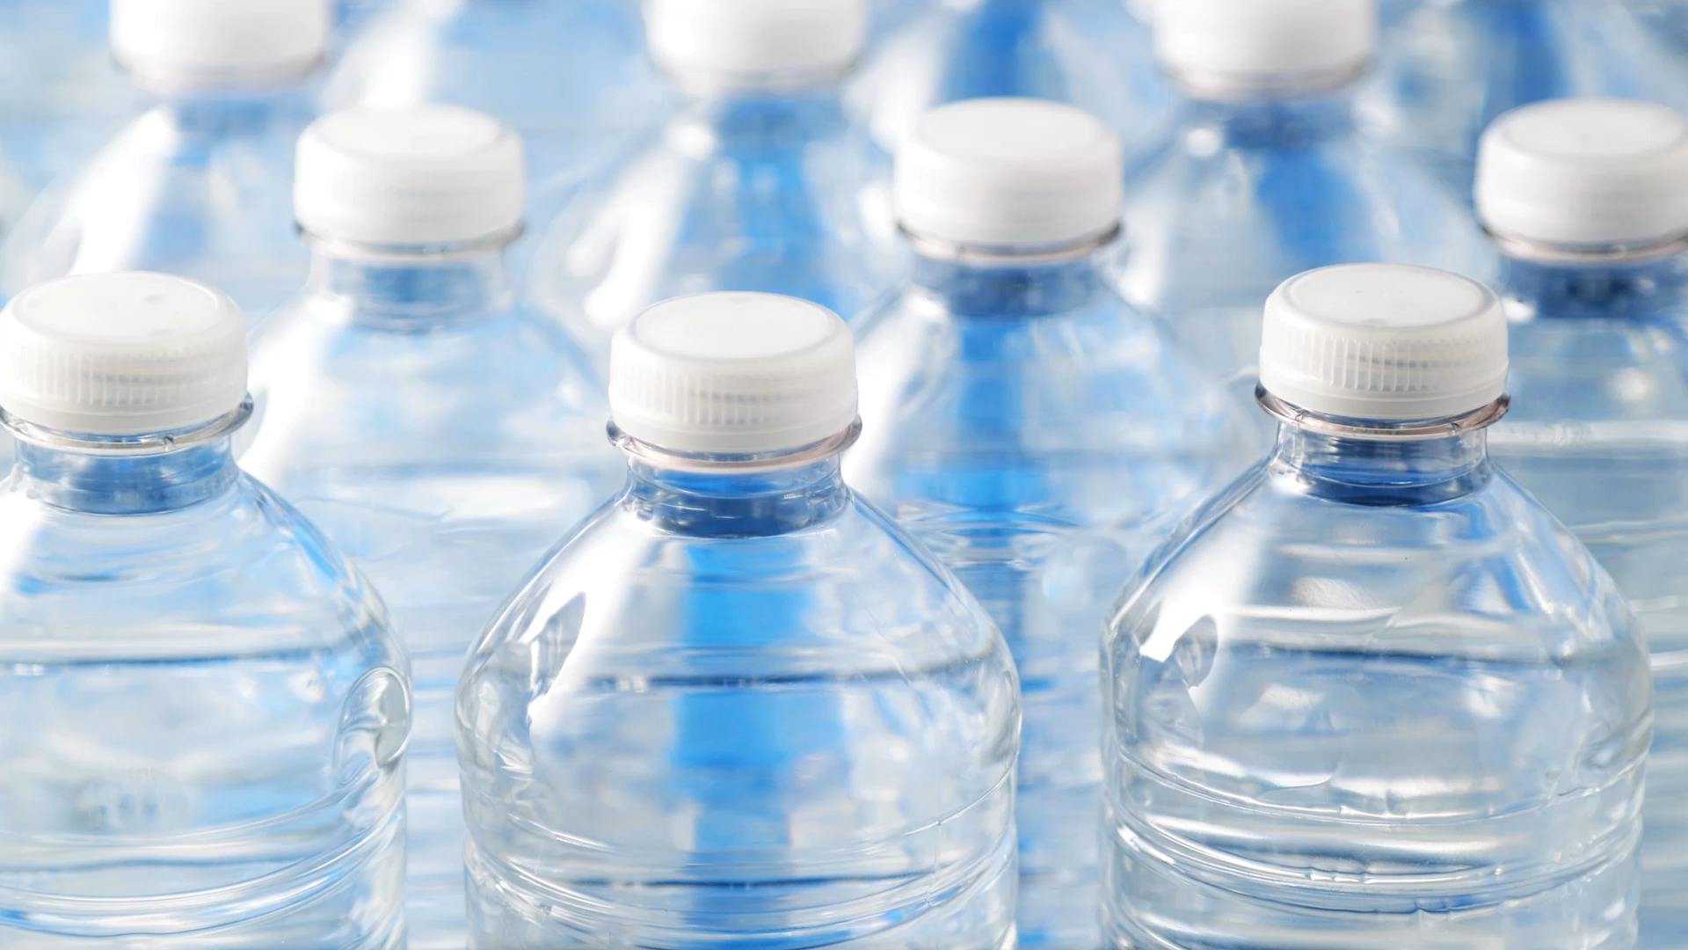
Predicting Water Potability Using Machine Learning
Logistic Regression • kNN • Random Forest

Slide 2

Introduction
Goal: Predict potability of water (Potable vs NotPotable)
Dataset: 3,276 water samples with 9 chemical features
Includes full ML pipeline: EDA, modeling, tuning, evaluation

Slide 3
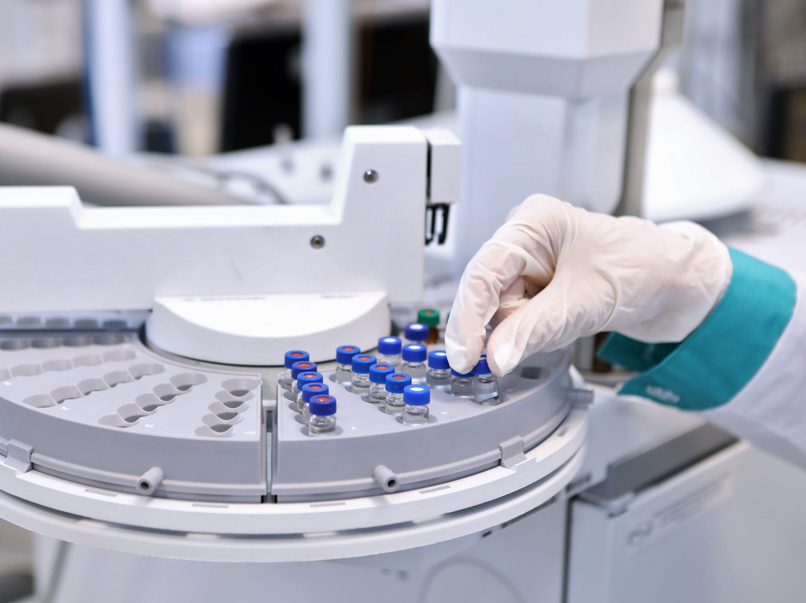
Preprocessing
Median imputation for missing values
Centering & scaling applied to all predictors
70/30 stratified train-test split

Slide 4

EDA Summary
Moderate class imbalance
Weak correlations between most features
pH, Sulfate, Chloramines show strongest predictive influence

Slide 5
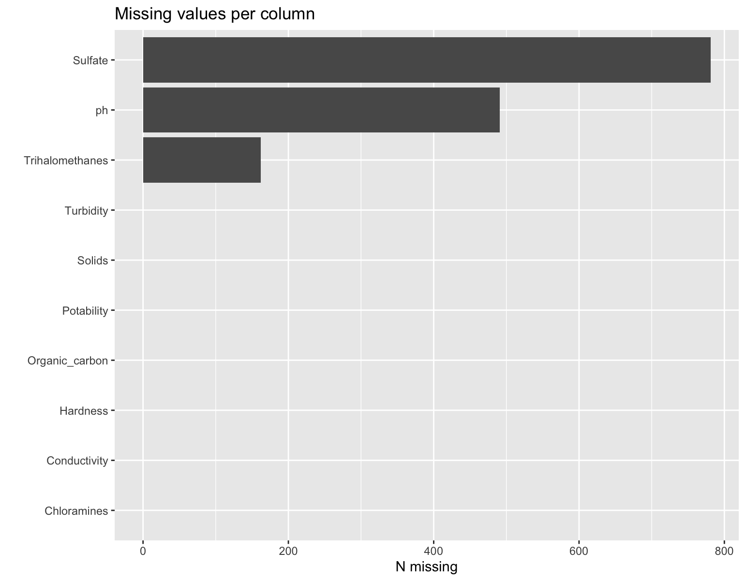
Missing Values per Column

Slide 6
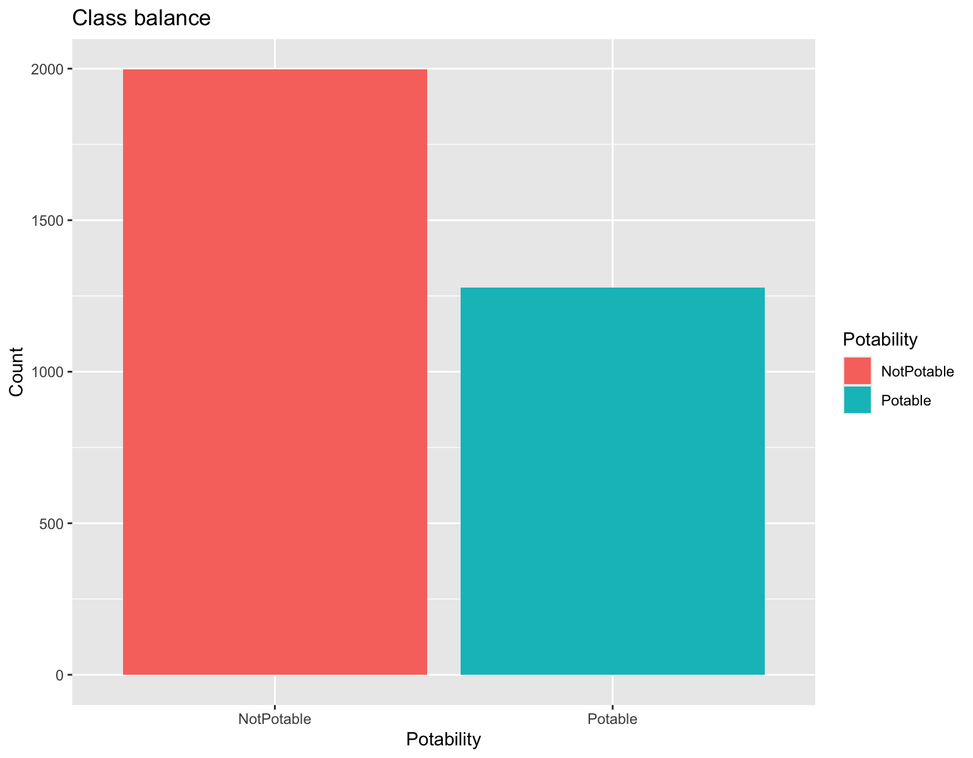
Class Balance

Slide 7
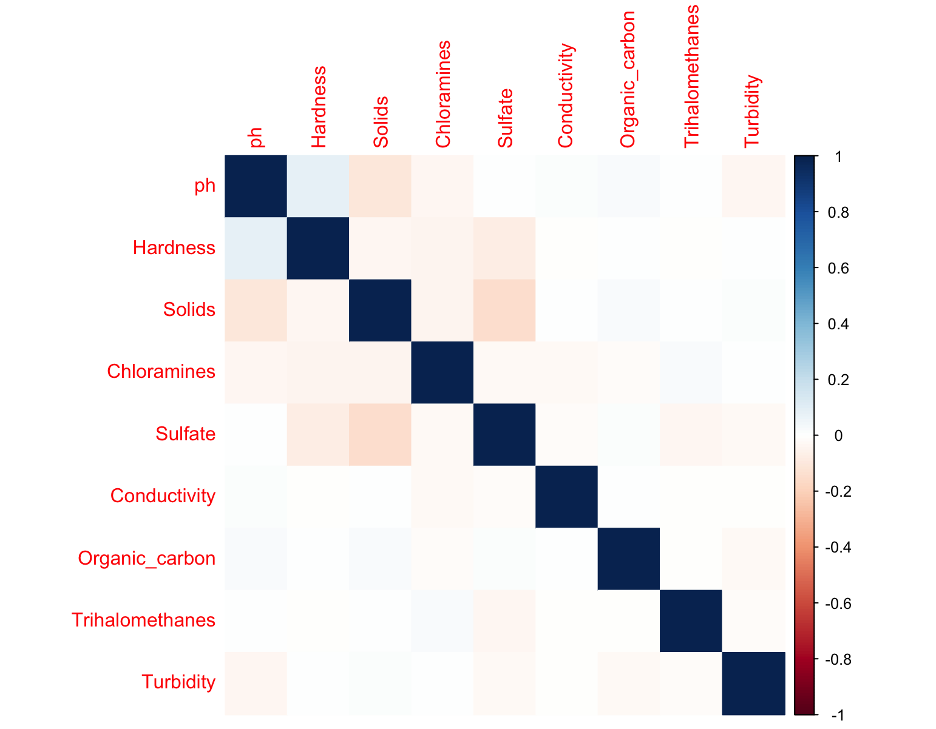
Correlation Heatmap

Slide 8
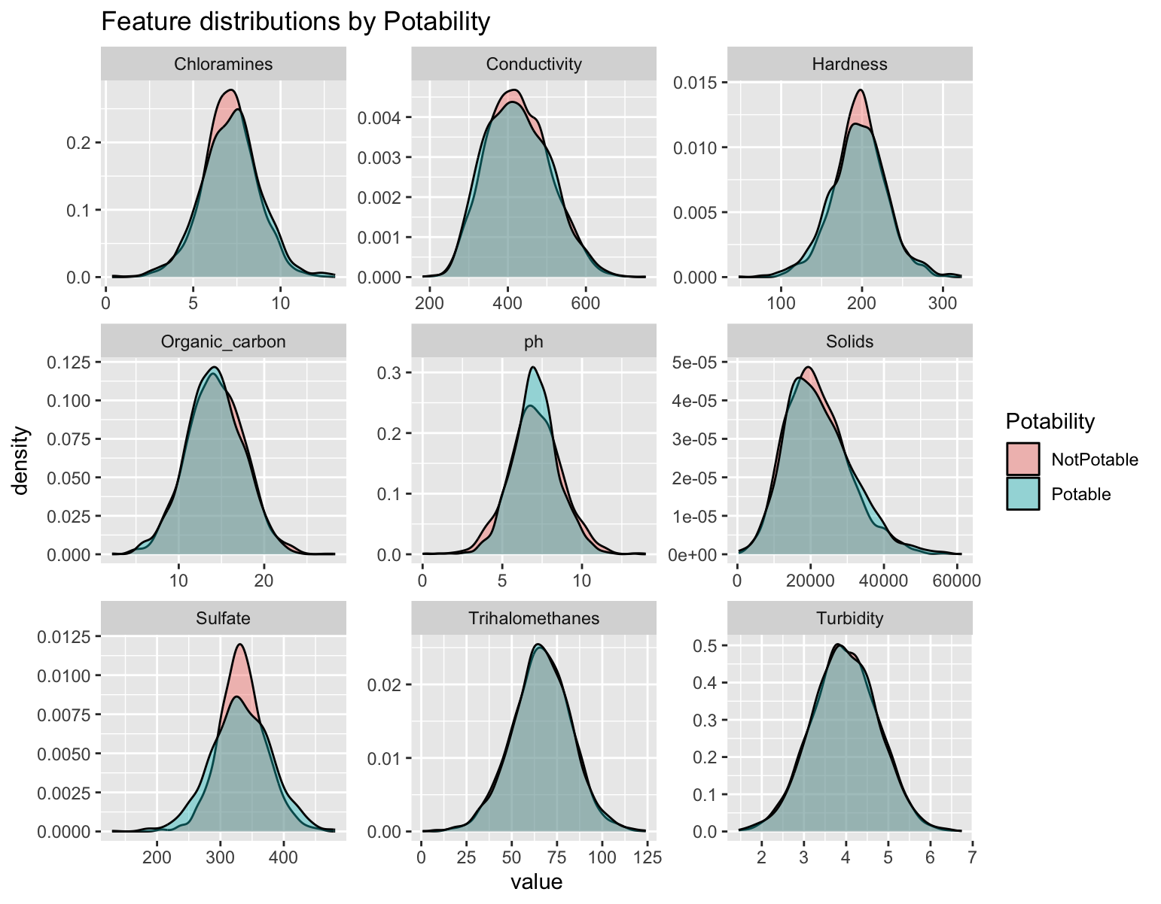
Feature Distributions by Potability

Slide 9
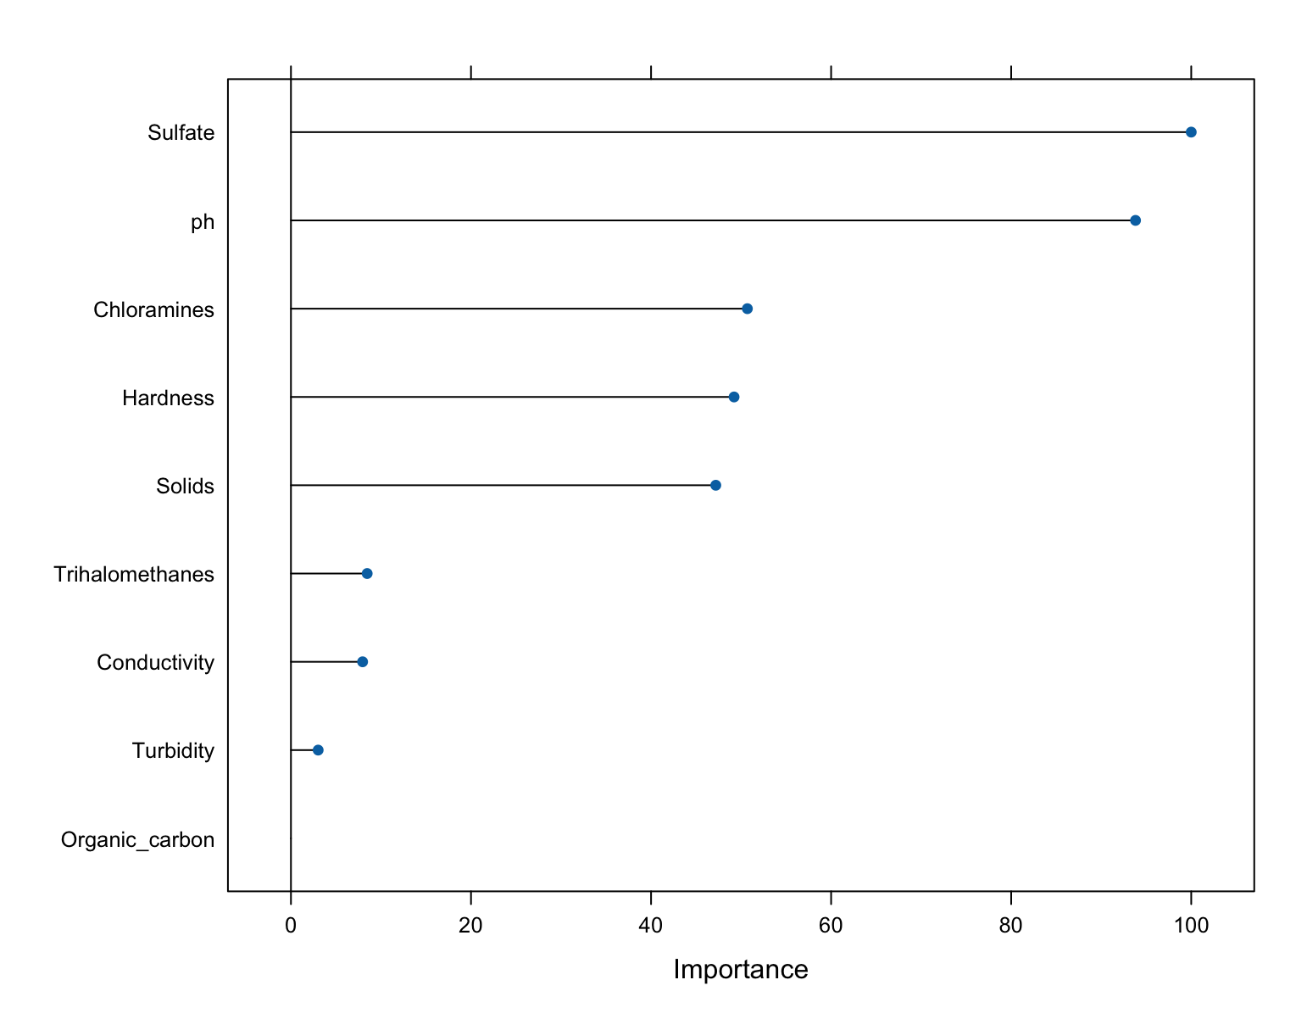
Random Forest Feature Importance

Slide 10

Models Used
Logistic Regression
k-Nearest Neighbors (kNN)
Random Forest (Selected as Best Model)

Slide 11
Model Results (CV AUC)
Logistic Regression: 0.491
kNN: 0.639
Random Forest: 0.678 (Best)

Slide 12
Random Forest Tuning
Grid search: mtry = 2 to 9
Best parameter: mtry = 7
500 trees, optimized for ROC

Slide 13
Final Evaluation (Threshold = 0.5)
Accuracy = 65.99%
AUC = 0.6776
Sensitivity = 0.376, Specificity = 0.841

Slide 14
Final Evaluation (Optimal Threshold)
Accuracy = 66.6%
AUC = 0.675
Sensitivity improved to 0.462
Balanced Accuracy = 0.629

Slide 15

Conclusion
Random Forest chosen as final predictive model
Moderate performance with meaningful chemical predictors
Useful for preliminary water quality assessment

